Slide 1



Slide 2


Making an orrery

Slide 3
Earth & Space
Learning Outcome:
To describe the movement of the Earth, and other planets, relative to the Sun in the Solar System

Slide 4
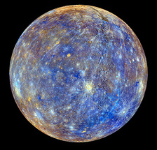
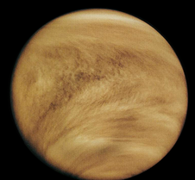
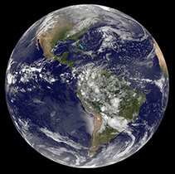
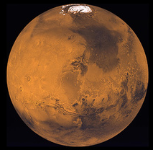
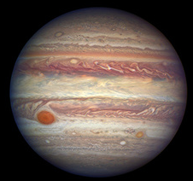
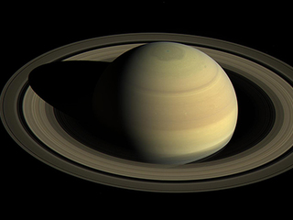
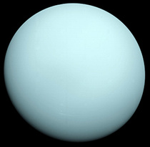
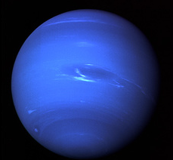
Can you remember the order of the planets?
My = Mercury
Very = Venus
Excellent = Earth
Moves = Mars
Image Credit: NASA
Jump & = Jupiter
Skip = Saturn
Under = Uranus
Neptune

Slide 5
What is an orbit?
An orbit is a circular pathway of one body around another.
All the planets orbit the Sun in an anti-clockwise direction

Slide 6
What is a year?
A year is the time it takes Earth to complete one orbit
The planets are not spaced out equally
One year on Earth is not the same as one year on any other planet.

Slide 7
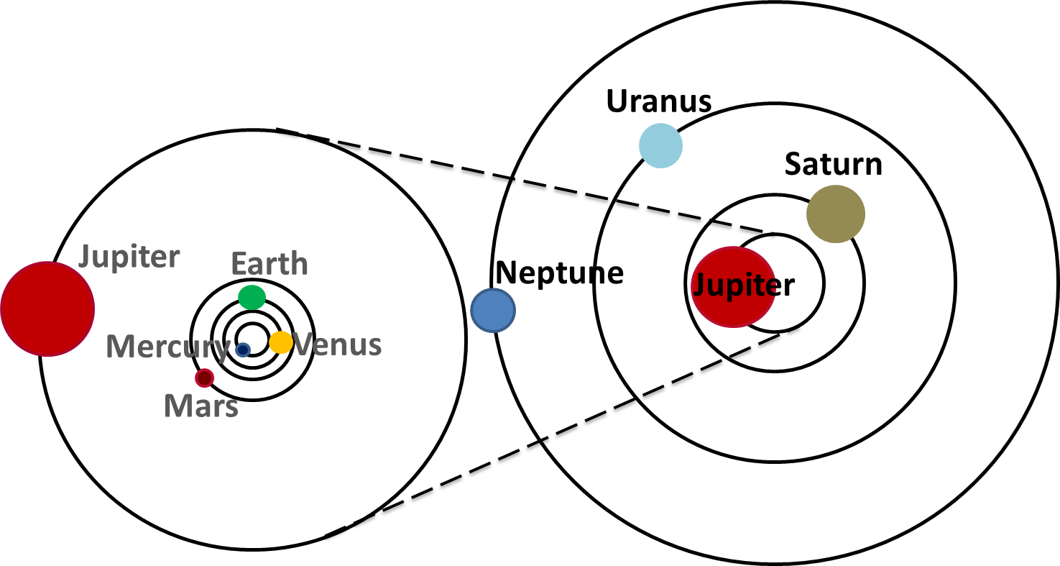
How long is a year on the outer planets?
All the planets orbit the Sun, but they take different lengths of time.
The outer planets take longer to orbit the Sun.

Slide 8
Making an Orrery
An orrery is a model of the Solar System that can be used to show the motion of the planets relative to the Sun and each other.

Slide 9
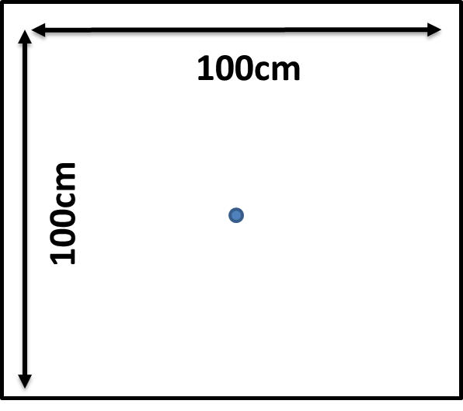
Step 1.
Join together sheets paper to make an area at least 1 meter by 1 meter.
Place a dot in the centre of the paper

Slide 10
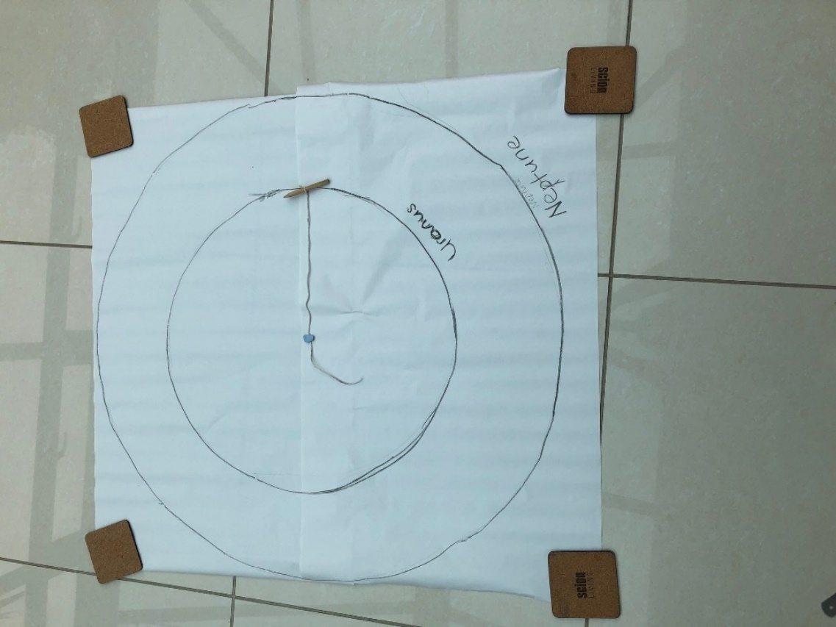
Step 2.
Tie one end of the string around the pencil/chalk and measure 50cm on the string.
Secure the other end of the string to the centre of the paper using the blu tack and draw a circle on the paper.
This represents the orbit of Uranus.
50cm

Slide 11
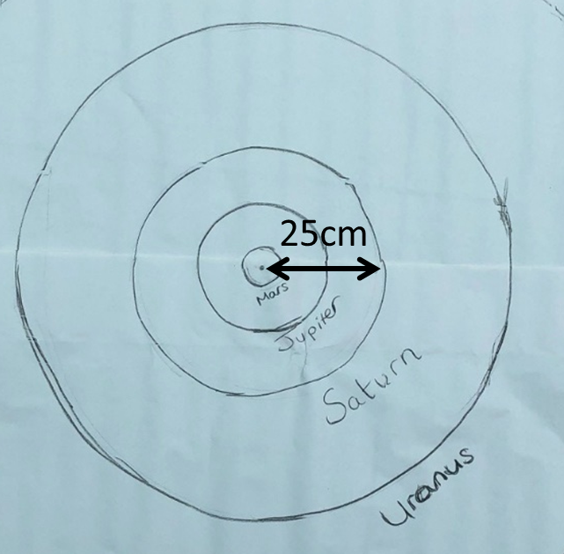
Step 3.
Shorten your string to 25cm and drawn another circle inside the first one.
This represents the orbit of Saturn.

Slide 12
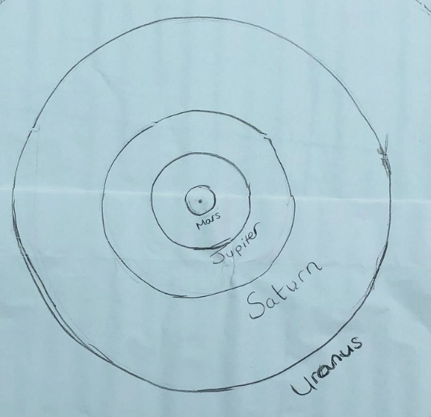
Step 4.
Shorten your string again to measure 13.5cm. This is the orbit of Jupiter.
Shorten your string again to measure 3.9cm. This is the orbit of Mars
You should have something that
looks a bit like this.

Slide 13
Step 5.
Shorten your string again to measure 2.5cm, draw another circle inside the orbit of Mars.
This represents the orbit of Earth.

Slide 14
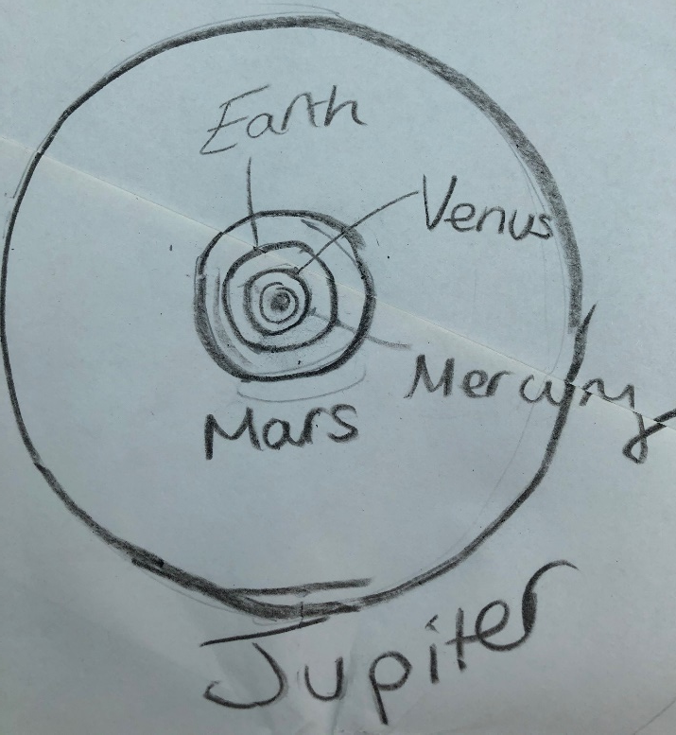
Step 6.
It is hard to use the string now so use a ruler and measure 1.8cm from the centre of the circles on each side, and join the dots with a circle by hand.
This is the orbit of Venus.
Do the same again, measuring just 1cm from the centre.
This is the orbit of Mercury.

Slide 15
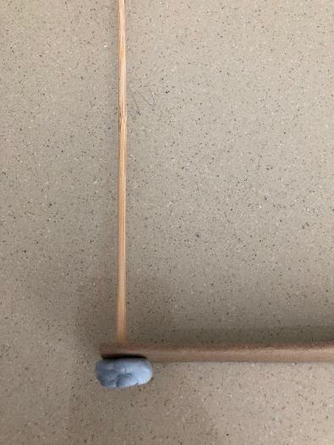
Step 7.
Cut the cardboard into a strip 51cm long and 3cm wide.
Pierce the cardboard at one end with the cocktail stick (you may need your teacher to help here) and place the blue tack underneath to keep the cocktail stick in place.
This is the moveable orbit of Uranus.

Slide 16
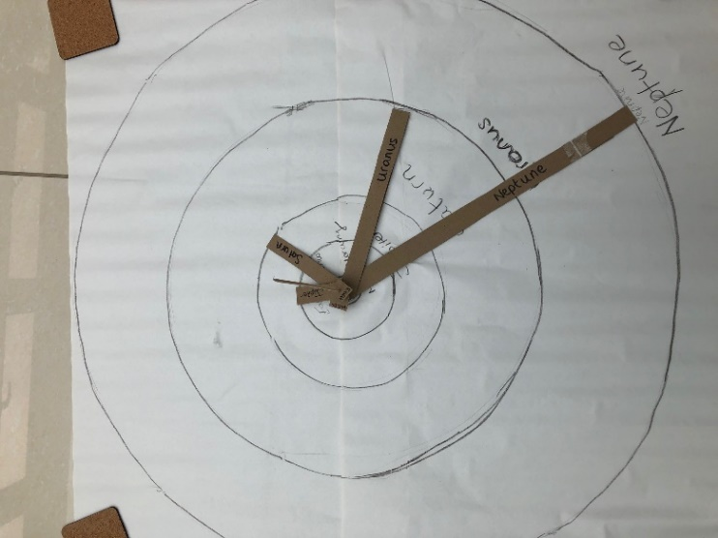
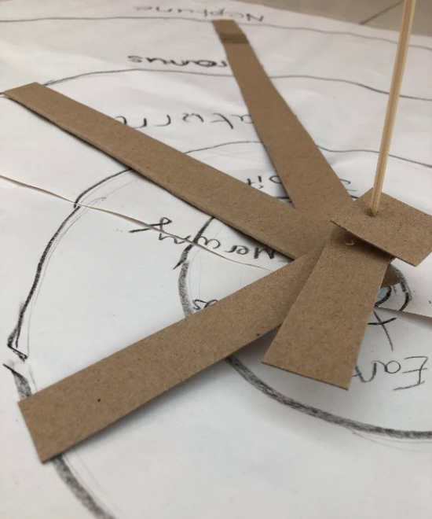
Step 8.
Cut another piece of cardboard 26cm long and 3cm wide, pierce at one end and add over the top of the cocktail stick. This is the orbit of Saturn, add it to your orrery.
Repeat with cardboard 14.5cm in length and 3cm wide. This is the orbit of Jupiter, add it to your orrery.

Slide 17
Step 9.
Repeat with cardboard 4.5cm in length for Mars’ orbit, add it to your orrery.
Repeat with cardboard 3.5cm in length for Earth, add it to your orrery.
Repeat with cardboard of 3cm in length for Venus’ orbit, add it to your orrery.
Repeat with cardboard of 2cm in length for Mercury’s orbit, add it to your orrery.

Slide 18
Step 10.
On each moveable orbit, add the name of the planet either using the name labels or the images provided.
You are now ready to investigate how quickly the planets move.

Slide 19
How the planets move: Uranus & Jupiter

Slide 20
Orbits of Uranus and Jupiter
Jupiter takes 12 years to orbit the Sun once.
Uranus takes 84 years to orbit the Sun once.
If we divide 84 by 12, we see that in the time it takes Uranus to orbit the Sun once, Jupiter has completed 7 orbits of the Sun.
84 ÷ 12 = 7 orbits
Can you show this using the cardboard arms on your orrery?

Slide 21

How far has Uranus moved?
Jupiter takes 12 years to orbit the Sun once.
Uranus takes 84 years to orbit the Sun once.
If we divide 12 by 84, we see that in the time it takes Jupiter to orbit the Sun once, Uranus has only moved 1/7th of its orbit around the Sun.
12 ÷ 84 = $\frac{1}{7}$ th of an orbit.
Let’s show this using the cardboard arms on your orrery.

Slide 22
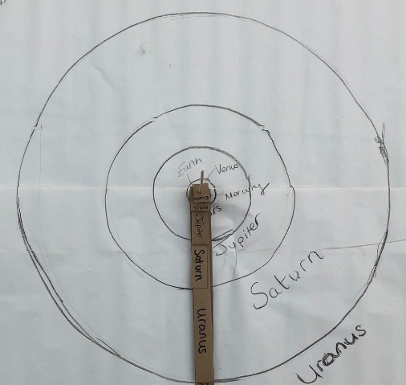
How far has Uranus moved?
Start with all the orbital arms in line.
In 12 years, Jupiter is just about to complete one orbit, or 360 degrees.

Slide 23
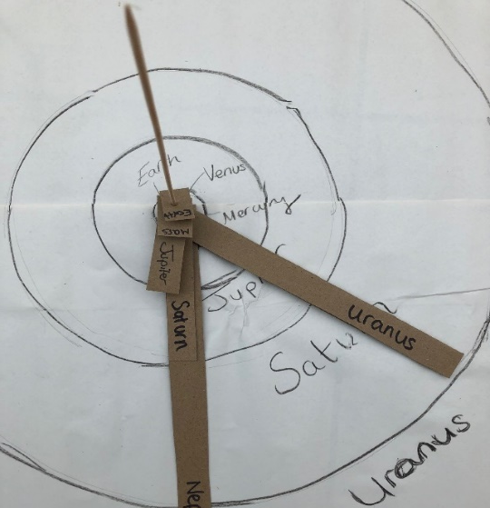

How far has Uranus moved?
In 12 years, Uranus has moved 1/7th of its orbit.
360 degrees x $\frac{1}{7}$ th = 51 degrees
Can you move the orbit of Uranus to 51 degrees?

Slide 24
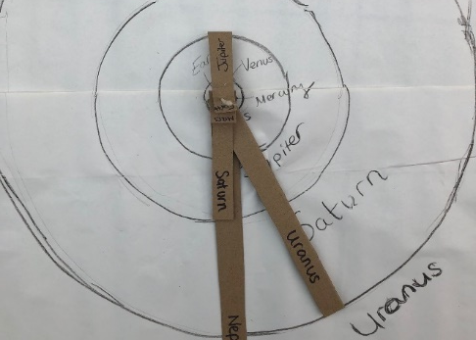

How far has Uranus moved?
In 6 years, Jupiter has moved ½ of its orbit, or 180 degrees.
In 6 years, Uranus has moved:
180 degrees x $\frac{1}{7}$ th = 25 degrees
Can you move the orbit of Uranus to 25 degrees?

Slide 25
Why don’t you investigate how many orbits the other planets will have completed in 6 years?

Slide 26
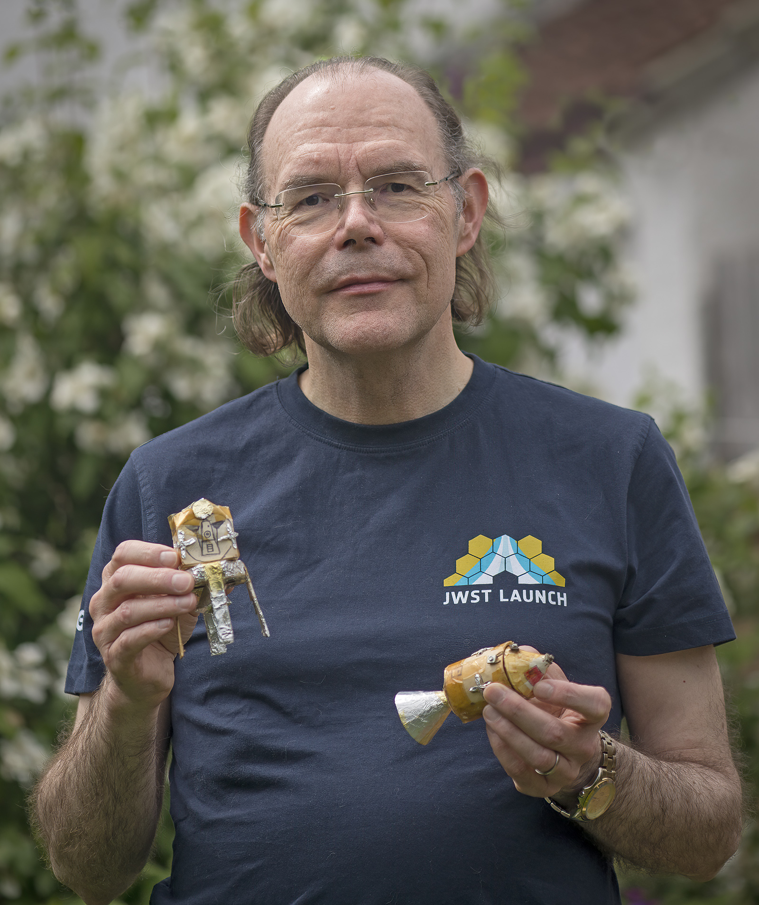
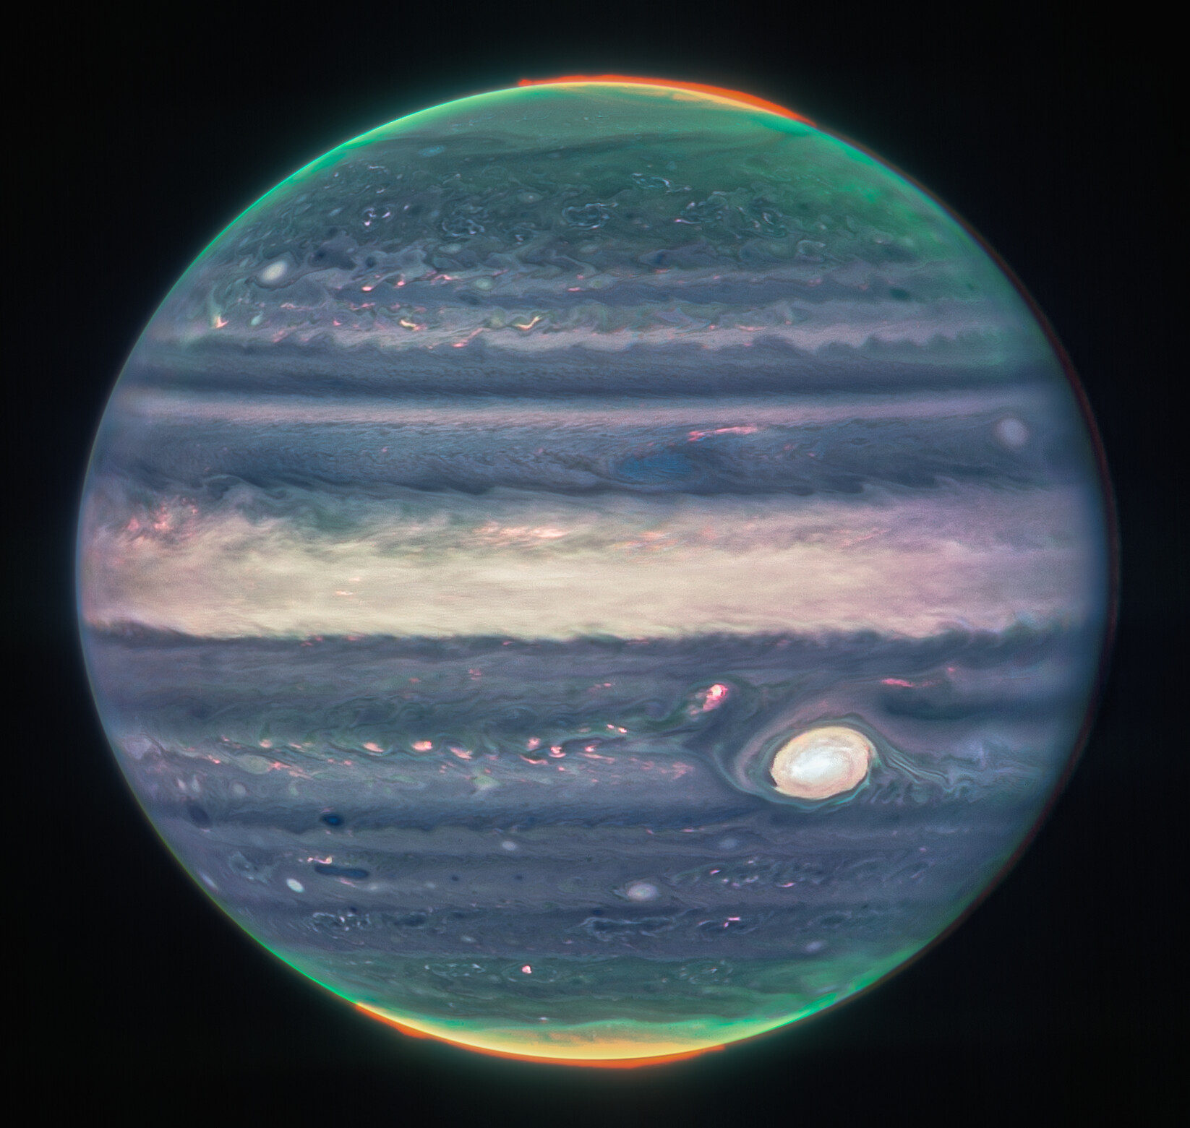
Career Focus: Steven Beard Software Engineer. “I program the computers that astronomers use to control the instruments on their telescopes” Steven has worked on the Webb Space Telescope which has taken pictures of our Solar System like this one of Jupiter.
Image Credit: NASA, ESA, Jupiter ERS Team; image processing by Judy Schmidt
Notes:
Images of the Solar System from Webb here: Image Archive: Solar System |ESA/Webb (esawebb.org)

